Slide 1
Anime Recommendation SYSTEM
Home
About
Dataset
Visualization
Data Model
NORA ALAMRI

Slide 2
TABLE OF CONTENTS
01
ABOUT
02
Dataset
03
04
Data Model
Visualization
01
02
Recommendation System
Preparation, Clean and Merge.
03
04
KNN, Cluster.

Slide 3
01
ABOUT
Home
About
Dataset
Visualization
Data Model
01
Recommendation System

Slide 4
INTRODUCTION
Home
About
Dataset
Visualization
Data Model
Recommender systems have taken more and more place in our lives. aimed at suggesting relevant items to users (items being movies to watch, text to read, products to buy etc..

Slide 5
WHAT IS Recommender Systems Means?
Home
About
Dataset
Visualization
Data Model
Recommender systems are algorithms aimed at suggesting relevant items to users (items being movies to watch, text to read, products to buy or anything else depending on industries). Here we built to recommend and predict anime for users. explore the contents of this dataset to gain insights
Analysis
Evaluation

Slide 6
THE GOALS
Home
About
Dataset
Visualization
Data Model
The goal of this project is to recommend and make predictions about a user’s taste of what a user will want to watch later.

Slide 7
How was the data prepared?
Data Loading
Data Exploring
Data Cleaning
Data visualization
Data Preprocessing
Data splitting
Home
About
Dataset
Visualization
Data Model

Slide 8
02
Dataset provided by Kaggle website
Home
About
Dataset
Visualization
Data Model
02

Slide 9
Data sources provided by Kaggle website
Home
About
Dataset
Visualization
Data Model
Two sample:
ANIME sample contains 12294 rows x 7 columns
RATING sample contains 7813737 rows x 3 columns
Sample AFTER merge and clean contains 7402 rows x 8 columns

Slide 10
Duplicates
Remove duplicate data
Trailing
Removes trailing characters
Missing
Filling the missing value
Home
About
Dataset
Visualization
Data Model
Data Cleaning

Slide 11
02
Data Visualization
Exploring Data Analysis
(EDA)
Home
About
Dataset
Visualization
Data Model
03

Slide 12
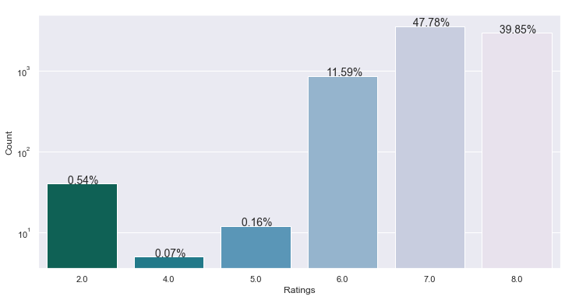
Count Of Rating
Home
About
Dataset
Visualization
Data Model

Slide 13
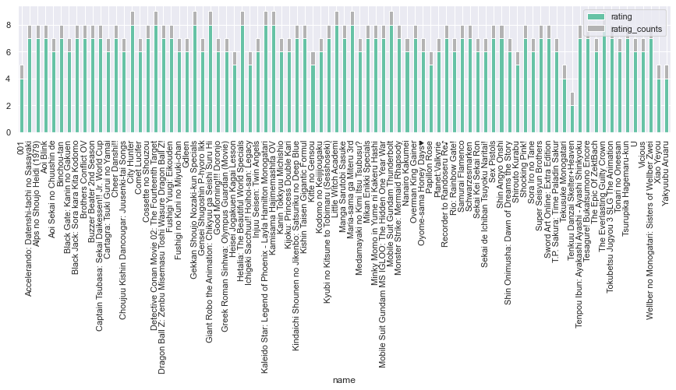
List the anime name with the rating
Home
About
Dataset
Visualization
Data Model

Slide 14
Top average rating of anime
Home
About
Dataset
Visualization
Data Model
 | Name | Average Rating
0 | City Hunter | 8.000
1 | Kyubi no Kitsune to Tobimaru (Sesshoseki) | 7.000
2 | Choujuu Kishin Dancougar: Juusenki-tai Songs | 6.000
3 | Gensei Shugoshin P-hyoro Ikk | 6.000
4 | Good Morning!!! Doronjo | 6.000
count 5.000
mean 6.600
std 0.894
min 6.000
25% 6.000
50% 6.000
75% 7.000
max 8.000
Name: Average Rating

Slide 15
Collaborative Filtering
Home
About
Dataset
Visualization
Data Model
Recommendations for user
0 Kimi no Na wa.
7683 Super Express Mazinger 7
8189 Backkom Meogeujan Yeohaeng
8190 Backkom Mission Impossible
8191 Backkom Specials
8192 Backstage Idol Story
8193 Bad Badtz-Maru no Ari to Kirigirisu
8194 Bad Badtz-Maru no Ookami ga Kita!
8195 Bad Badtz-Maru no Ore no Pochi wa Sekaiichi
8196 Bad Badtz-Maru no Ore wa Yuutousei

Slide 16
02
Data Model
Home
About
Dataset
Visualization
Data Model
04
You can enter a subtitle here if you need it

Slide 17
KNN Model
Home
About
Dataset
Visualization
Data Model
Similar to "Naruto"
Katekyo Hitman Reborn
Dragon Ball Z
Boku no Hero Academia
similar to "City Hunter"
City Hunter 2
City Hunter 3
CLAMP Gakuen Tanteidan
Similar to "Dragon Ball Super"
Dragon Ball Kai
Toriko
Rekka no Honoo

Slide 18
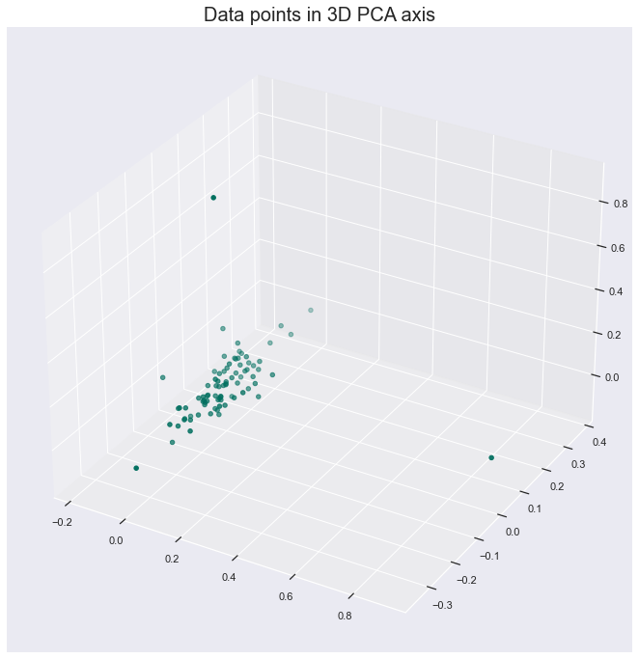

Cluster
Home
About
Dataset
Visualization
Data Model

Slide 19
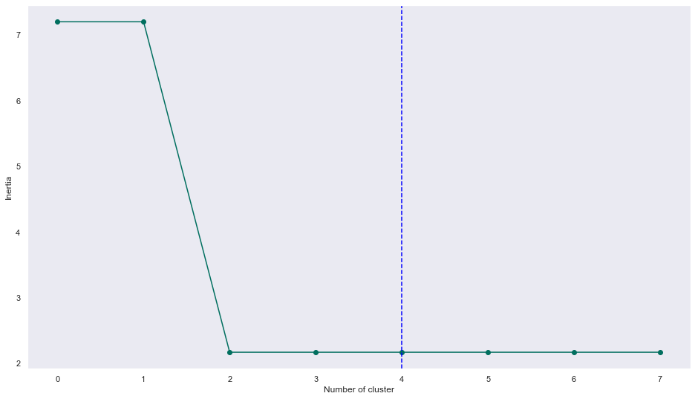
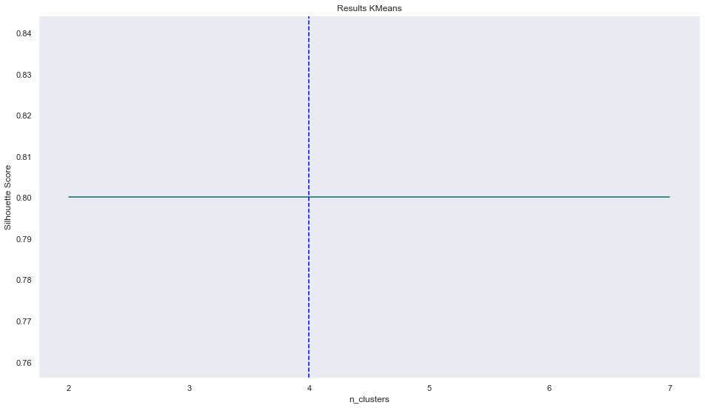
Cluster
Home
About
Dataset
Visualization
Data Model

Slide 20
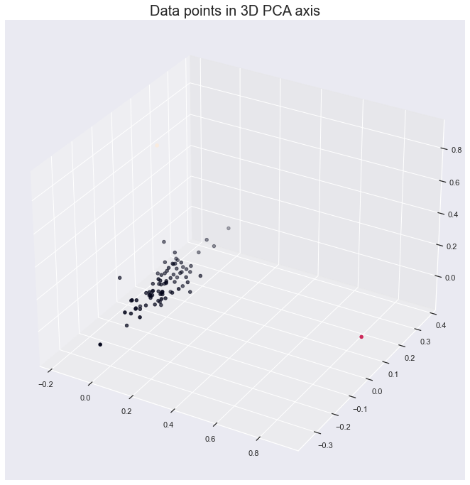
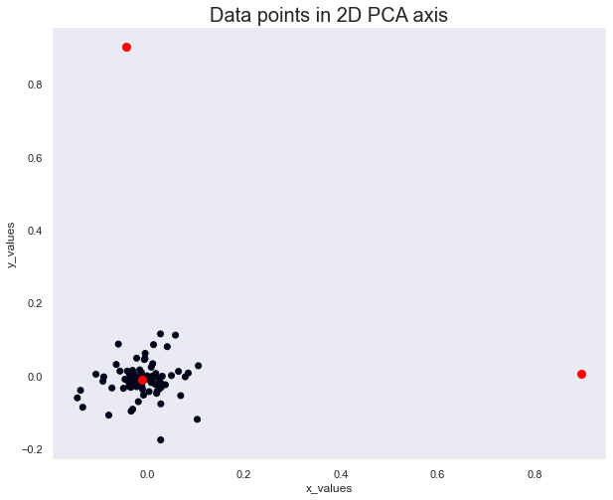
Cluster
Home
About
Dataset
Visualization
Data Model

Slide 21

Cluster
Home
About
Dataset
Visualization
Data Model
C0
Gensei Shugoshin P-hyoro Ikk | 0.333
Good Morning!!! Doronjo | 0.333
Kyubi no Kitsune to Tobimaru (Sesshoseki) | 0.333

Slide 22

Cluster
Home
About
Dataset
Visualization
Data Model
C1
Choujuu Kishin Dancougar: Juusenki-tai Songs | 0.000
City Hunter | 0.000
Gensei Shugoshin P-hyoro Ikk | 0.000

Slide 23

Cluster
Home
About
Dataset
Visualization
Data Model
C1
City Hunter | 1.000
Choujuu Kishin Dancougar: Juusenki-tai Songs | 0.000
Good Morning!!! Doronjo | 0.000

Slide 24
Home
About
Dataset
Visualization
Data Model
THANKS!
Do you have any questions?
It.nor00@gmail.com
https://github.com/NoraAlamri

